Slide 1
Mature Sons of the House:
Set your mind on things above
Col 3:1-17
16/12/18

Slide 2
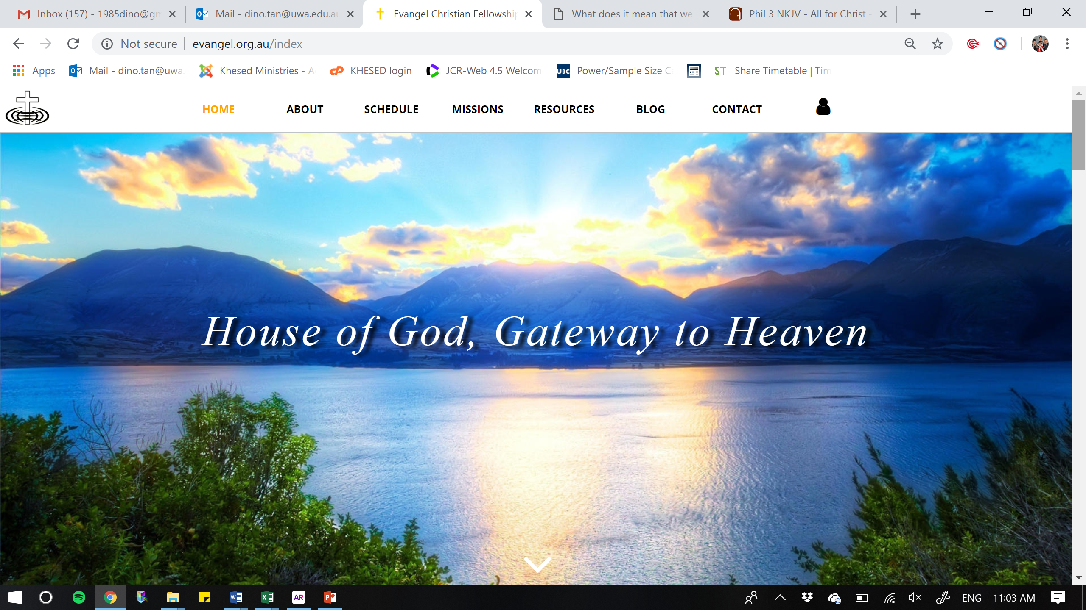
& from Heaven

Slide 3
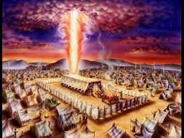
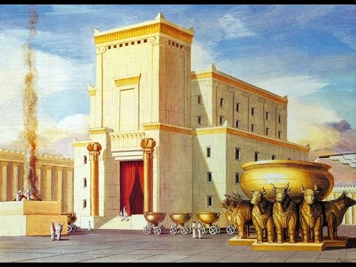
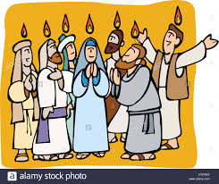
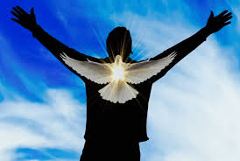

Slide 4

Theme 2018
STRATEGIC
Men & Women of Stature
POSITIONED
In Prophetic Precision
CREATING
Significant moves

Slide 5
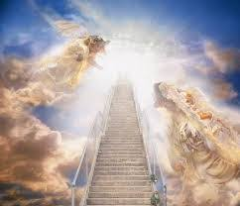
Our God reigns
The heavens are opened
For Spirit demonstration
Empowering His people
To do an impregnable work

Slide 6

The House of God
1. Jesus is Building His Church
2. Jesus is Measuring His Church
3. Jesus is Setting Order in His Church:
  Structure (The 5 Who’s; 1 Cor 12)
  Chain of authority
  Correction (Discipline; Heb 12:5-7)
  Hear and change
  Shaking (To prepare us; Heb 12:26-27)
  Religion, Pride, Idolatry

Slide 7
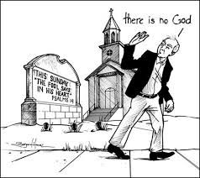
1) Forsake foolish ways
a) Does not know God

Slide 8

1) Forsake foolish ways
Does not know God
Does not do what he hears

Slide 9
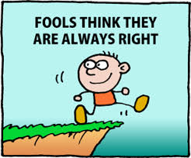
1) Forsake foolish ways
Does not know God
Does not do what he hears
Does not heed counsel

Slide 10

~
HEAR & DO
HEAR & DO
~
~
FOUNDATION (ROCK) = JESUS CHRIST

Slide 11
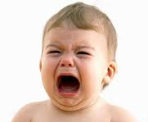
2) Forsake childish thoughts
Selfish thoughts
Carnal minded
Easily led astray
Eph 4:14 - that we should no longer be children, tossed to and fro and carried about with every wind of doctrine, by the trickery of men, in the cunning craftiness of deceitful plotting.

Slide 12
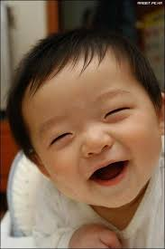
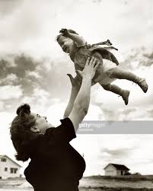
2) Childish vs childlike faith
Wants to know the truth
Humble to trust their parents
Find satisfaction with their parents
Matt 18:3-4 - “Assuredly, I say to you, unless you are converted and become as little children, you will by no means enter the kingdom of heaven. 4 Therefore whoever humbles himself as this
little child is the greatest in the
kingdom of heaven.

Slide 13
3) Forsake worldly things
Col 3:2-3 - ² Set your mind on things above, not on things on the earth. ³ For you died, and your life is hidden with Christ in God.
Set your affection = to exercise the mind, that is, entertain or have a sentiment or opinion; by implication to be (mentally) disposed (more or less earnestly in a certain direction); intensively to interest oneself in (with concern or obedience)

Slide 14

Set our minds on things above
1) Look at life from God’s perspective
2) And to seek after what He desires

Slide 15

1) Look from God’s perspective
Isa 55:9

Slide 16
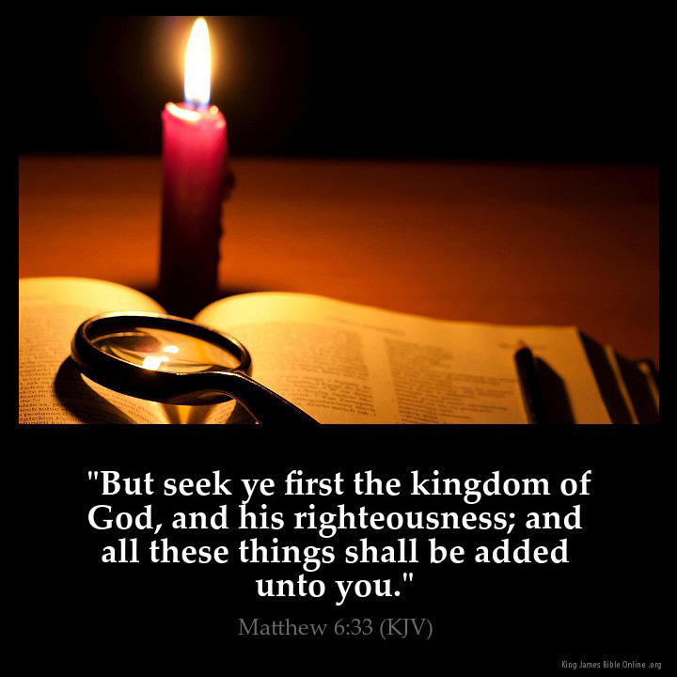
2) Seek after what He desires
Matt 6:33

Slide 17
2) Seek after what He desires
Col 3:3a For you died,
Col 3:3b and your life is hidden with Christ in God

Slide 18

Steps of action
Die daily (Rom 12:1-2)
Recognise that God is ‘bigger’ than us (Prov 3:5-6)

Slide 19
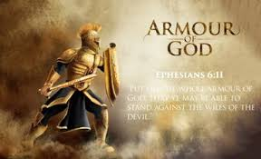
Steps of action
Die daily (Rom 12:1-2)
Recognise that God is ‘bigger’ than us (Prov 3:5-6)
Listen to His voice (Ps 46:10)
Put on His armour (Eph 6:13-18)

Slide 20

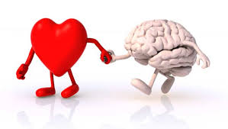
Steps of action
Die daily (Rom 12:1-2)
Recognise that God is
‘bigger’ than us (Prov 3:5-6)
Listen to His voice (Ps 46:10)
Put on His armour (Eph 6:13-18)
Guard our heart (Prov 4:23)

